Slide 1

JANUARY–JUNE 2023
Bright Coffee
Data Analysis
Revenue, customer demand and product performance
$698,812
149,116
TOTAL REVENUE
TRANSACTIONS
Management presentation
Notes:
Open with the growth story: Bright Coffee generated nearly $699k in six months and more than doubled monthly revenue from January to June.

Slide 2
EXECUTIVE SUMMARY
Growth is strong — and operationally concentrated
Revenue doubled across the period, with demand centered on morning hours and two core categories.
$698,812
214,470
149,116
$4.69
Revenue
Items sold
Transactions
Avg. transaction
01
Revenue momentum
02
Morning engine
June revenue reached $166k, 102% above January.
55% of items sold occur before noon.
03
Core category strength
04
Balanced footprint
Coffee and tea generate 67% of total revenue.
All three stores contribute roughly one-third of revenue.
Management focus
Protect the morning rush, deepen coffee and tea attachment, and convert strong traffic into a higher basket value.
Notes:
This is the one-minute summary.

Slide 3
GROWTH
Monthly revenue more than doubled by June
The trajectory accelerated sharply from March, reaching $166k in June.
+102%
JAN → JUN
3.8×
REVENUE VS FEB LOW
Watch next
Sustain the post-March momentum and identify the campaigns, products or customer patterns behind the acceleration.
Notes:
Monthly revenue declined slightly in February, then rose for four consecutive months.

Slide 4

DAYPART
The business is built around the morning rush
10:00 is the top revenue hour; 09:00–12:00 is the largest item-selling period.
55% of items sold before noon
Operating implication
Schedule strongest coverage for 07:00–11:00, protect espresso throughput, and stage fast-moving products before opening.
Notes:
Nearly 118 thousand items were sold before noon.

Slide 5
PORTFOLIO
Coffee and tea produce two-thirds of revenue
The core beverage franchise is strong; bakery is the leading food attachment.
66.7%
COFFEE + TEA REVENUE
$82,316
BAKERY REVENUE
Portfolio move
Use bakery bundles to lift basket value during the morning rush; preserve coffee and tea availability as traffic anchors.
Notes:
Coffee and tea together contribute roughly 67% of revenue.

Slide 7
PRODUCTS
Barista Espresso leads revenue; tea leads unit volume
Revenue leadership and unit-volume leadership come from different products.
TOP PRODUCT TYPES BY REVENUE
TOP PRODUCTS BY ITEMS SOLD
Merchandising move
Feature high-revenue espresso alongside high-volume tea products; test bakery attachments across both missions.
Notes:
Barista Espresso leads product-type revenue; Earl Grey Regular leads item volume.

Slide 8

TRAFFIC MAP
Revenue intensity is strongest from 08:00 to 10:00
Morning strength appears consistently across the week.
Peak hour
10:00 produces $88k in revenue.
Stable weekdays
Daily revenue ranges only 5%.
Late-day taper
Revenue falls materially after 18:00.
Scheduling lens
Concentrate labour, prep and recovery capacity around 08:00–10:00.
Notes:
The morning peak is consistent across the week.

Slide 9
90-DAY ACTION AGENDA
Turn traffic into
higher-value growth
01
Own the morning
Protect 07:00–11:00 speed, availability and staffing.
02
Lift the basket
Bundle bakery with coffee and tea during peak periods.
03
Scale what works
Share product and service practices across all stores.
04
Track the levers
Review hourly revenue, basket value and attachment weekly.
Success: sustain revenue growth while increasing the $4.69 average transaction value.
Notes:
Close on four actions.

Slide 10
APPENDIX
Source dashboard
Original pages retained for reference

Slide 11
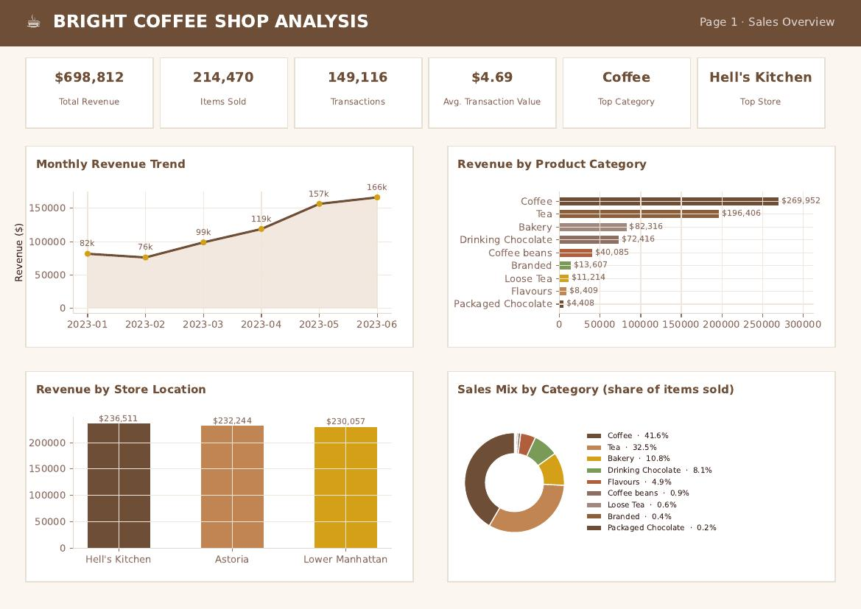
SOURCE DASHBOARD • PAGE 1
11

Slide 12
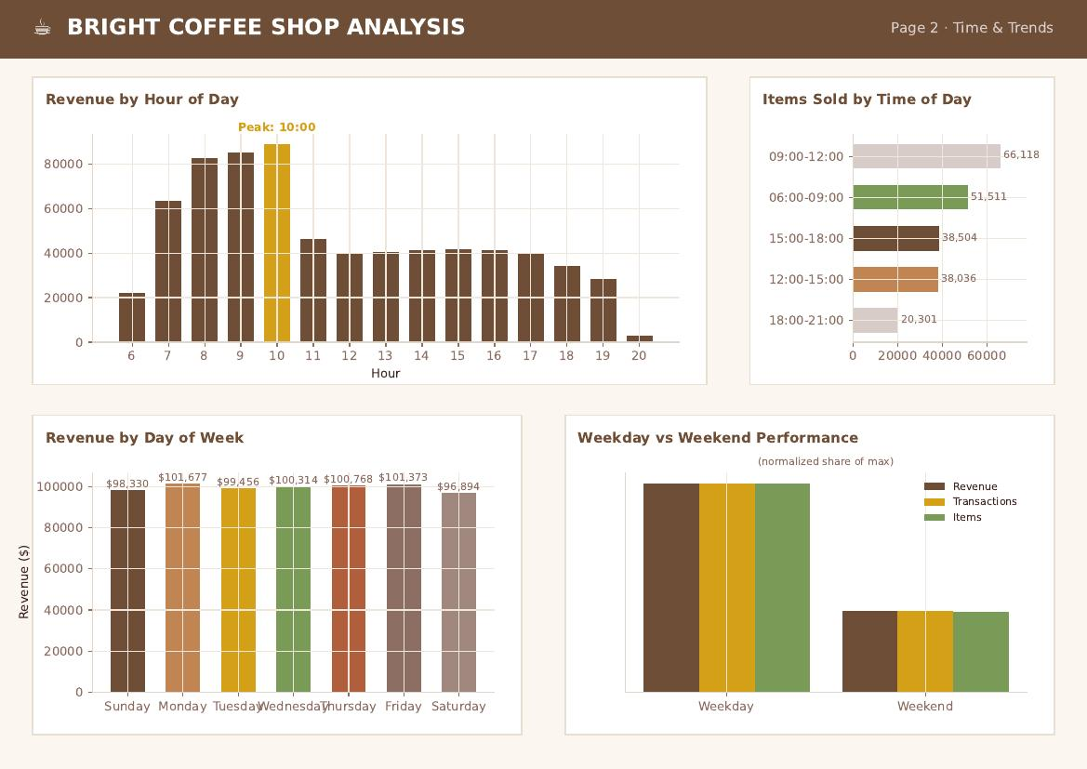
SOURCE DASHBOARD • PAGE 2
12

Slide 13
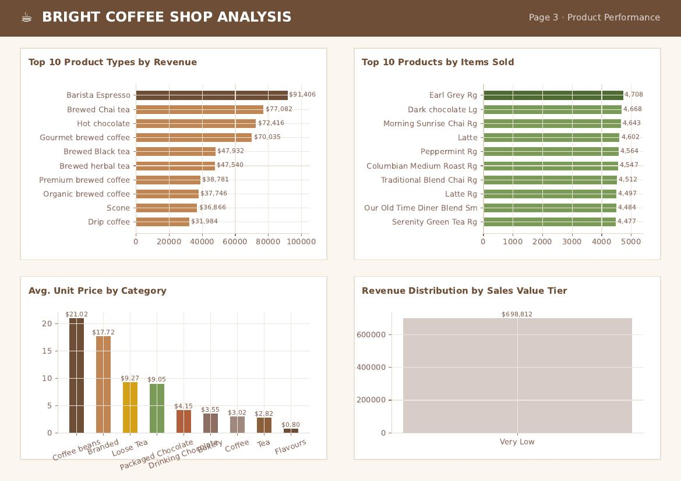
SOURCE DASHBOARD • PAGE 3
13

Slide 14
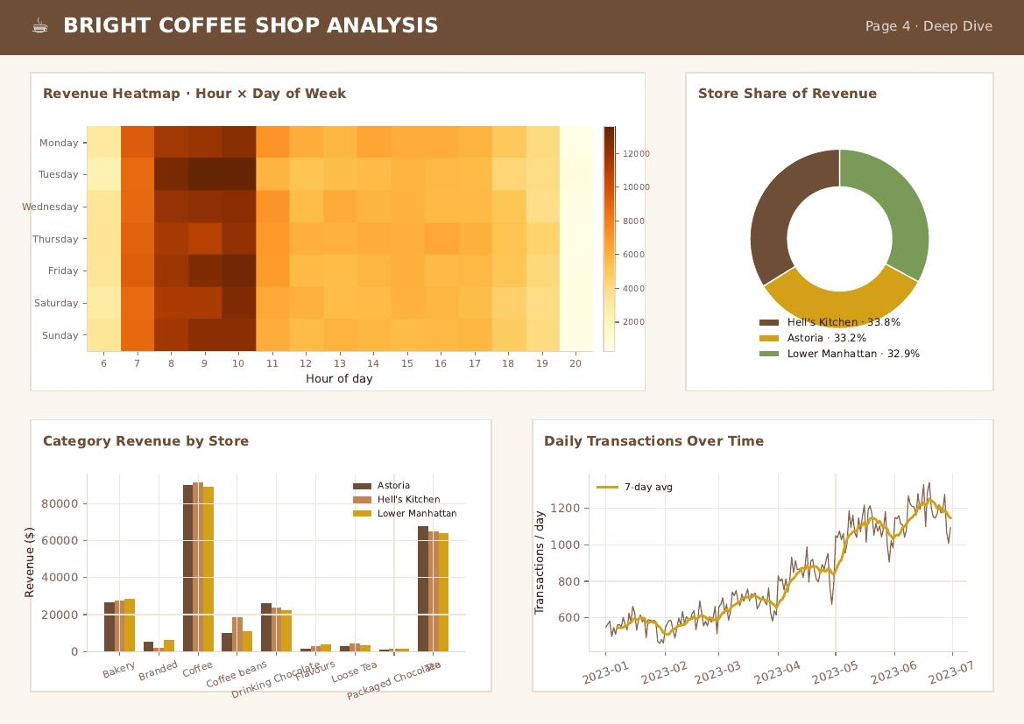
SOURCE DASHBOARD • PAGE 4
14

